Slide 1

Front - end engineering project-I
TEAM DETAILS -:
GROUP –I
B.TECH -CSE
GROUP 2
FACULTY COORDINATOR-:
Dr. Ravneet Kaur
Chitkara University Institute of Engineering and Technology,
Chitkara University, Punjab

Slide 2
Table of Contents
•Introduction
•Problem Statement
•Technical Details
•Key Features
•Project Highlights
•Conclusion
•References/Links used

Slide 3
INTRODUCTION
Name of the project- Personal Resume Page
Group member details-
Dhairya Bansal (Group Head) - 2410990126.
Esha – 2410990146
Iyra- 2410990367
The main purpose of the project is to create personal resume page for professional use.
The goal is to help in developing an attractive and easy version of creating resume rather than hustling in search of a good resume.

Slide 4
PROBLEM STATEMENT
What recruiters look for ?
recruiters spend an average of only 6-7 seconds reviewing a resume before deciding whether to move forward
How to get it overlooked?
well-organized, clear, and visually appealing resume can lead to many candidates being overlooked.

Slide 5
TECHNICAL DETAILS
The project is made with help of front-end engineering using HTML, CSS and linking it further with java as back end .
HTML is used as layout and for fundamental structuring .
CSS is used for styling of pages.
JavaScript Functionalities is used for creating new resume.

Slide 6

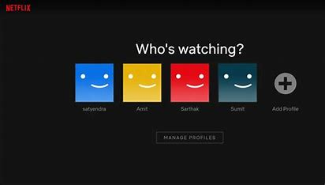
KEY FEATURES
1. We have made the project taking the idea of Netflix and having it as our layout
2. The resume will be shown in form of icons like in Netflix
By clicking on profile, the resume of the person will open helping in giving different designs for resume

Slide 7
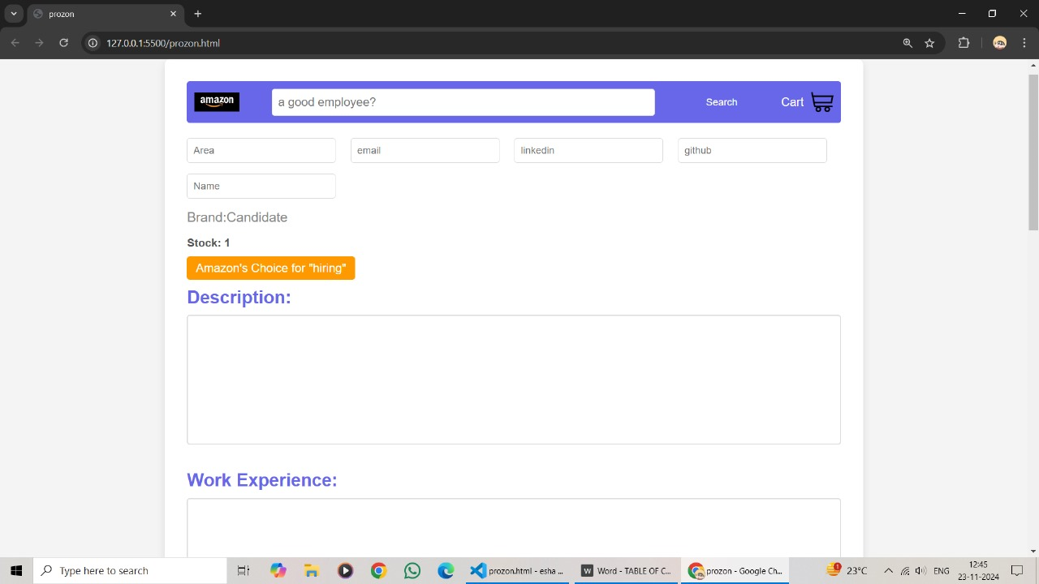

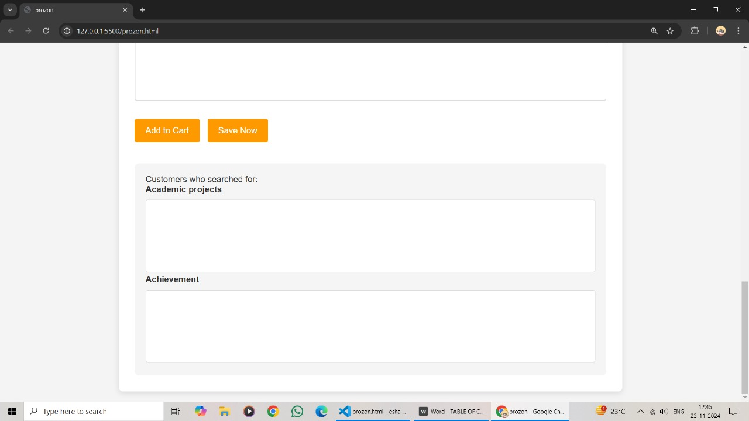
1. We have made the project taking the idea of Amazon and having it as our layout 2. The resume will be shown in form of icons like in Amazon By clicking on prozon, the resume of the person will open helping in giving different designs for resume

Slide 8
Customizable layout
Responsive design
Downloadable resume option
Interactive contact form
Social media integration
Dynamic sections
Real-time preview
Version control
Seo optimization

Slide 9
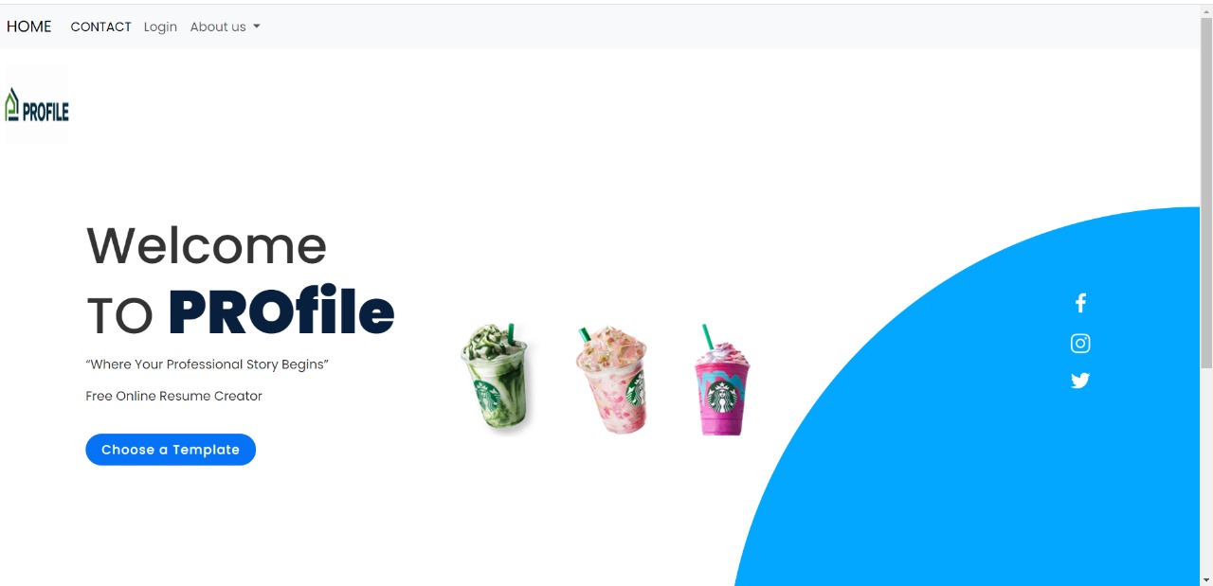
HOME PAGE OF THE SITE

Slide 10
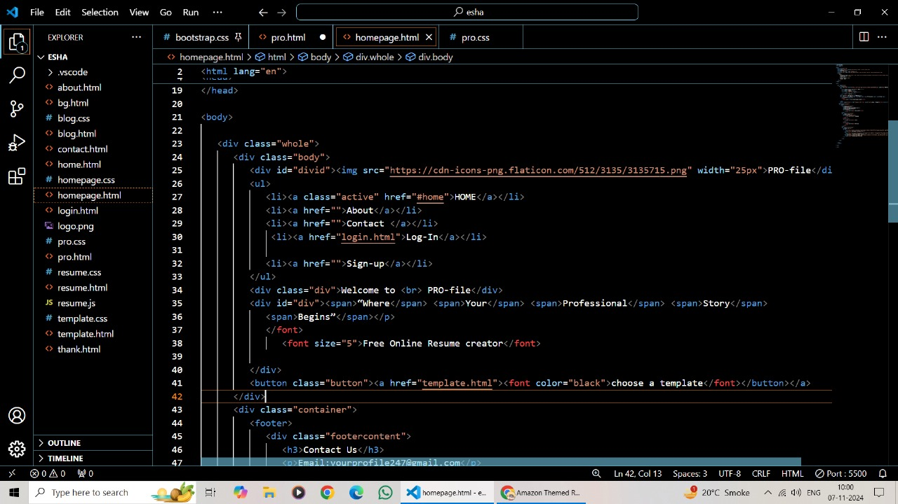
CODE OF HOMEPAGE

Slide 11
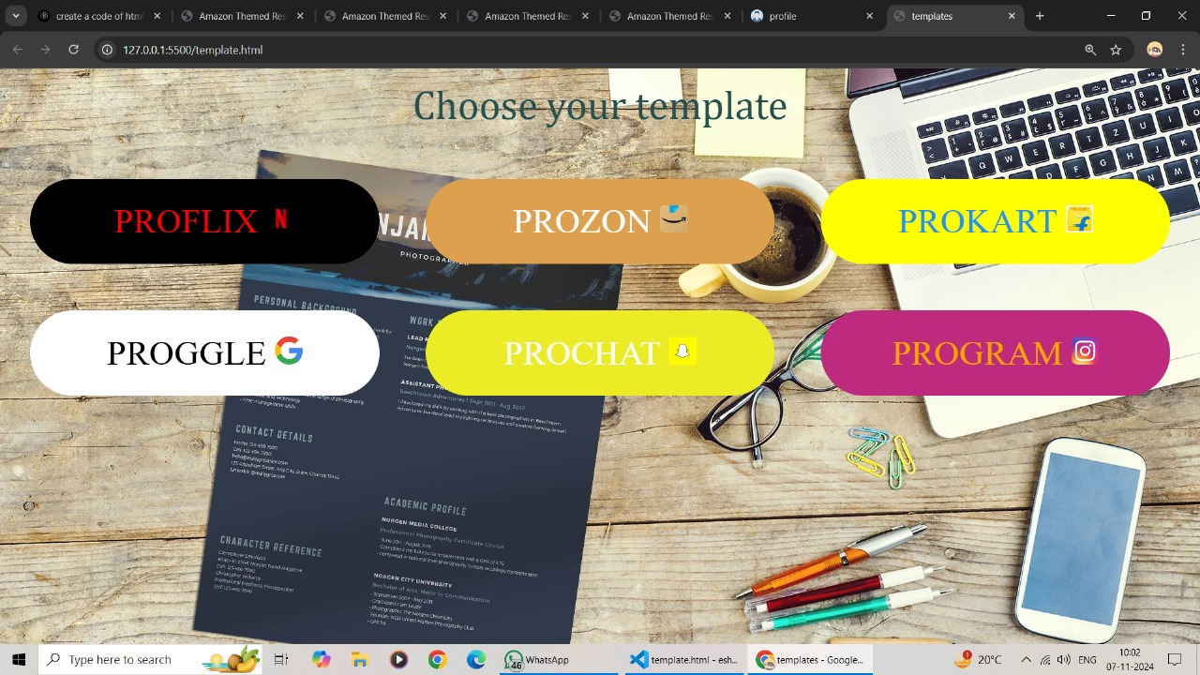
TEMPLATE PAGE OF THE SITE

Slide 12
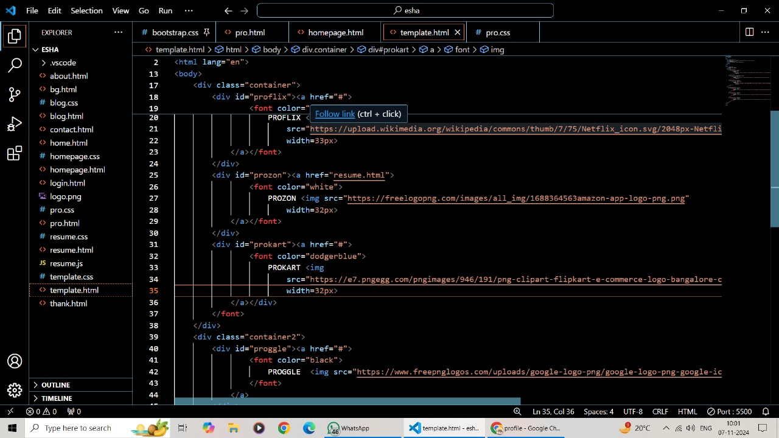
CODE OF TEMPLATE PAGE

Slide 13
PROJECT HIGHLIGHT
Customizable and dynamic design
User friendly interference
Quick and efficient resume review
Improved visual appeal
Increased engagement with recruiter
Accessibility and easy sharing
Multi-platform compatibility

Slide 14
CONCLUSION
The Personal Resume Page project provides a creative and user-friendly solution to the challenge of designing and sharing resumes. By incorporating a Netflix-inspired layout and utilizing modern web technologies like HTML, CSS, and Java, the platform offers users an innovative way to present their professional profiles. The project succeeds in enhancing the visibility of resumes, making them more attractive and easier to navigate for recruiters. The focus on visual appeal and functionality not only improves the candidate’s chances of being noticed but also simplifies the process of creating and updating resumes.

Slide 15
REFRENCE/LINK USED
Application used for coding – Visual Studio Code
Chat GPT used for help in coding and knowing functions
Link- ChatGPT | OpenAI
Link- NETFLIX Clone using HTML, CSS and JS – CodeWithCurious
AMAZON Clone using HTML, CSS and JS – CodeWithCurious
Image links-
https://th.bing.com/th/id/OIP.DBcPn4EoS749TymynvHH2AHaEK?rs=1&pid=ImgDetMain
https://th.bing.com/th?id=OIP.61E1UaSAiZvMq2HVos9M8gHaEK&w=333&h=187&c=8&rs=1&qlt=90&o=6&dpr=1.3&pid=3.1&rm=2

Slide 16
Thank you

